Slide 1
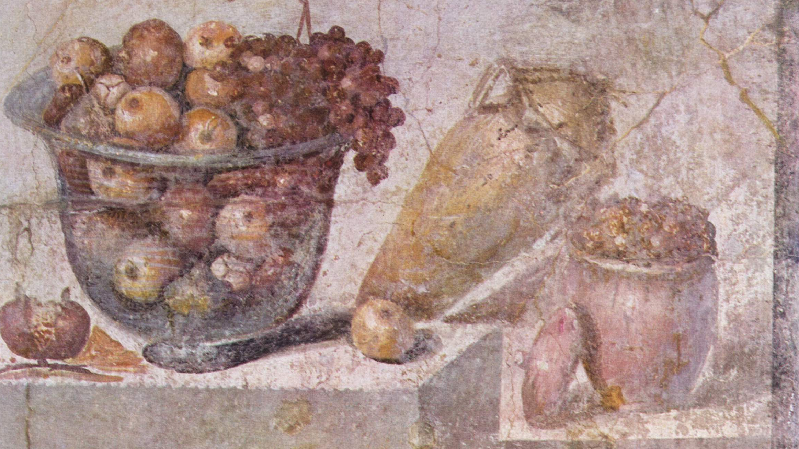
Appetitus rationi pareat
De Officiis – On Duties
Book I, section 141
Desire ought to obey reason
What Meals & Food Would
Cicero Have Eaten?

Slide 2
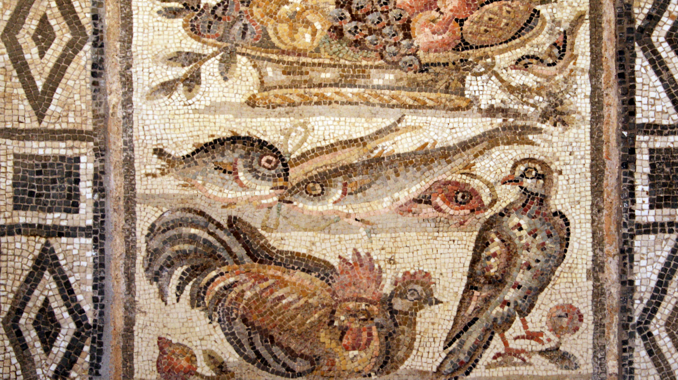
Agenda
Finding books
A few key resources for Classics
Finding articles
Cite your sources
Search on your own

Slide 3
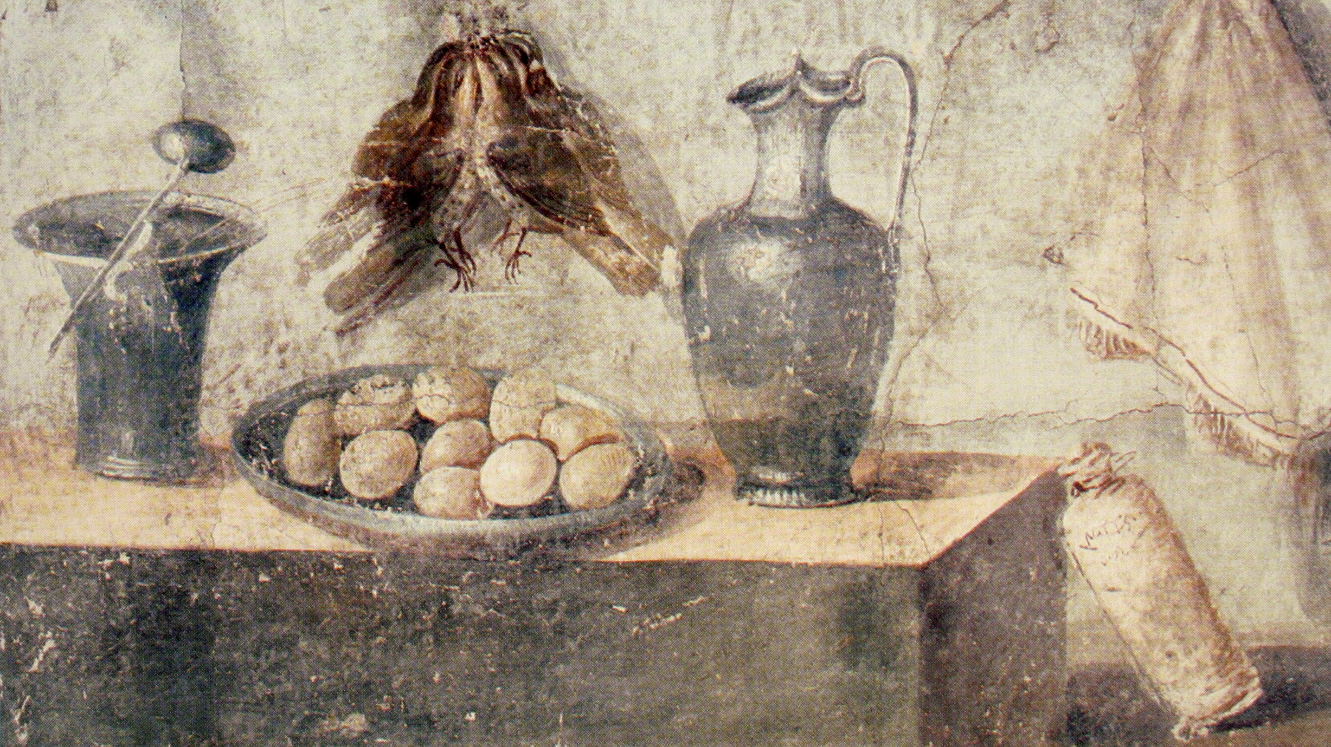
Start General
Try to define what your question is about:
Question 2 is ultimately a question about food, dinning and meals specific to the culture, social life, and customs of Rome
Nota Bene: Libraries might use special terms
If you can figure out the terms, you can find the resources!
There are always a multitude of sources, so let the experts help point the way:
Professor Phillips
A Research and Instruction Librarian
The sources we will look at
Figure out: is this more likely to be a book topic, or an article topic:
Cutting edge research is frequently found in articles
Established subjects usually have books

Slide 4
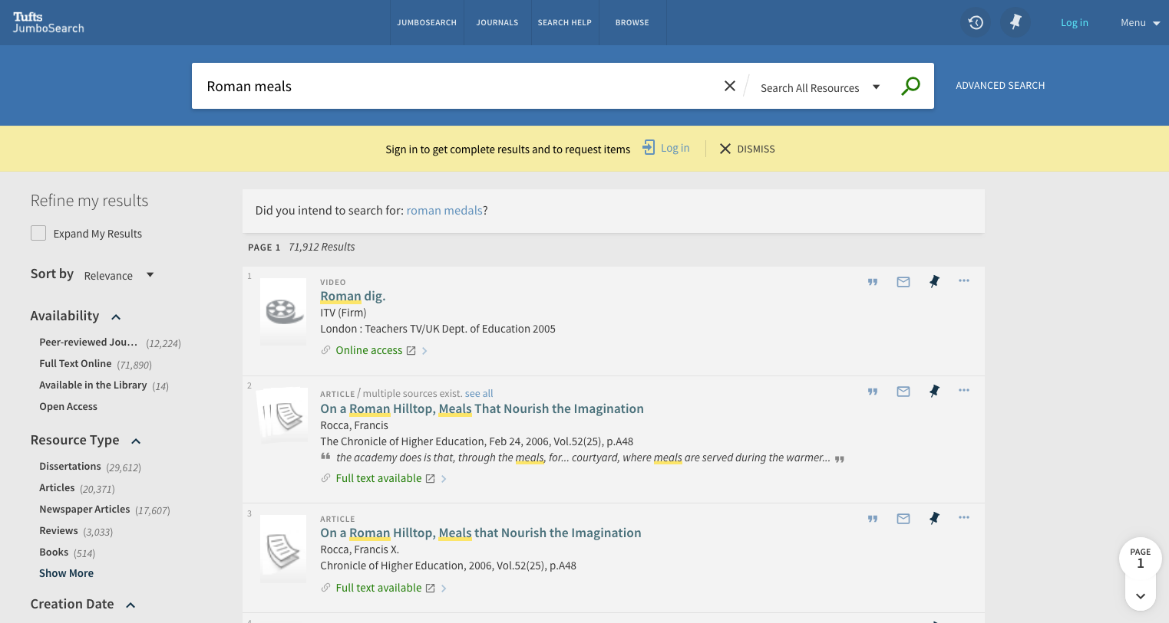
General Catalog Search: Recall
Notes:
KW: Roman meals, dinning, etc… = too many results. You need to narrow it down.

Slide 5
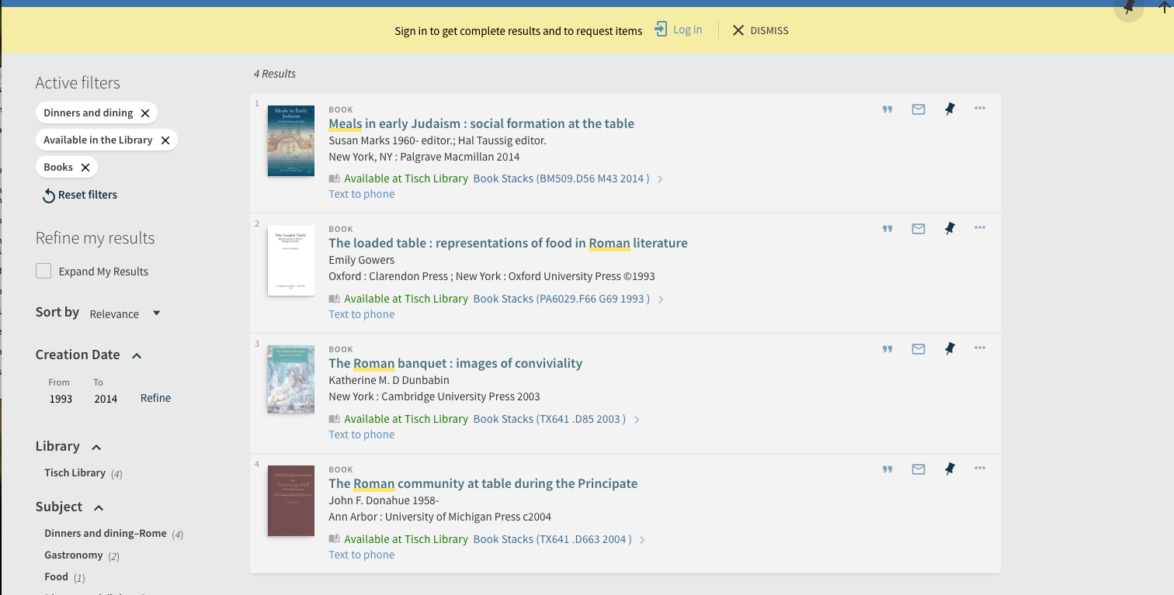
General Catalog Search: precession through Facets
Notes:
If your kw doesn’t surface a potential source, you may want to try facets to help find an item, from which you can get really precise results through the browse function

Slide 6
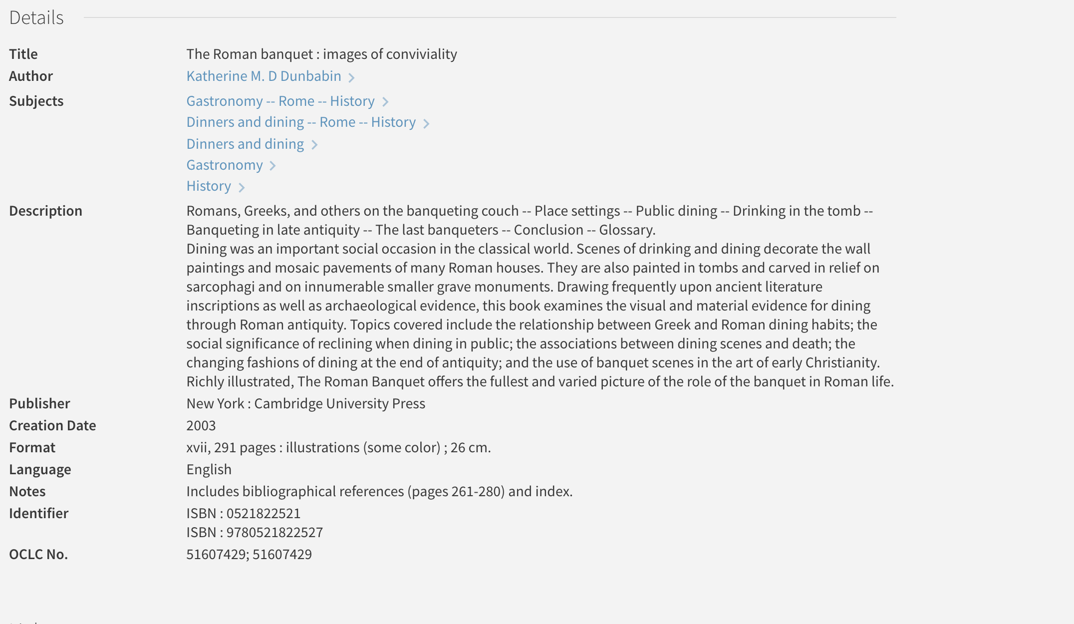
Look for specific terms!

Slide 7
Look for specific terms!
Notes:
* technique 1: follow up on the good items

Slide 8
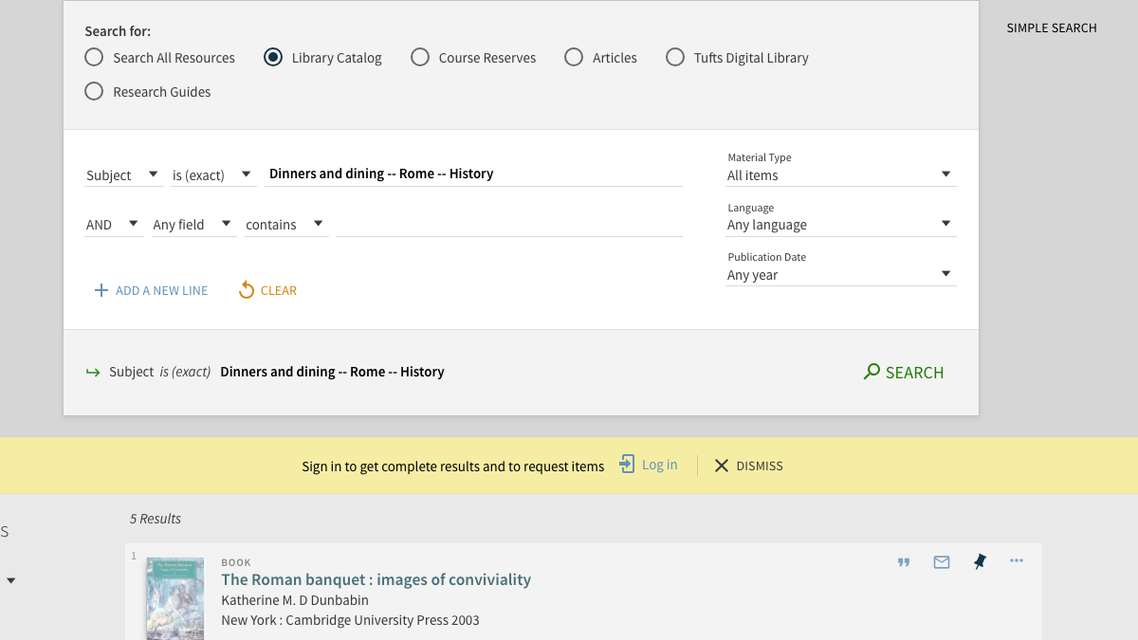
General Catalog Search: Precession through known Subject
Notes:
* technique 1: follow up on the good items—use the subjects you found!

Slide 9
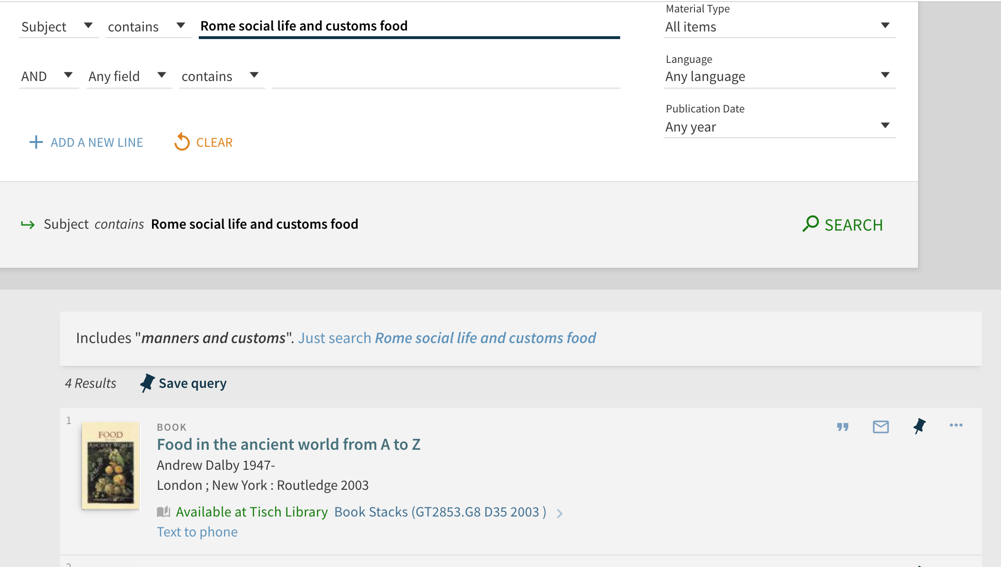
General Catalog Search: Precession through Expanded Subject
Notes:
* technique 2: SU: Rome social life and customs
* other useful searches:
* KW rome social life (your topic)
* KW (rome or roman) (your topic)

Slide 10
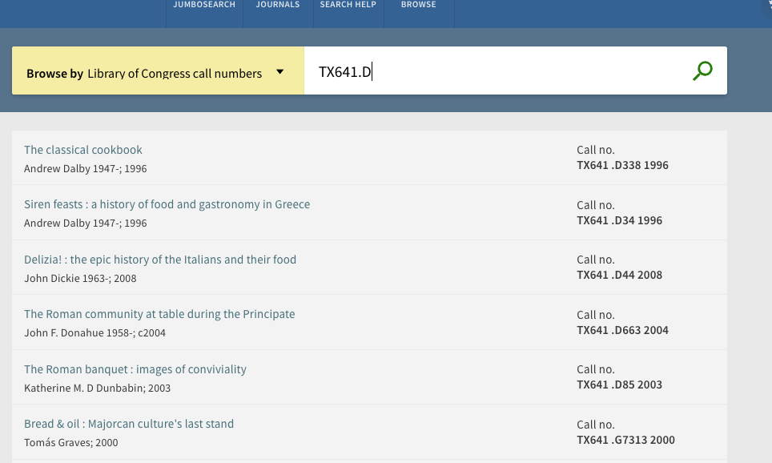
General Catalog Search: Precession through Call Number Browse
Notes:
You can also browse by title, author, and call number.. Try browsing for: Z5

Slide 11
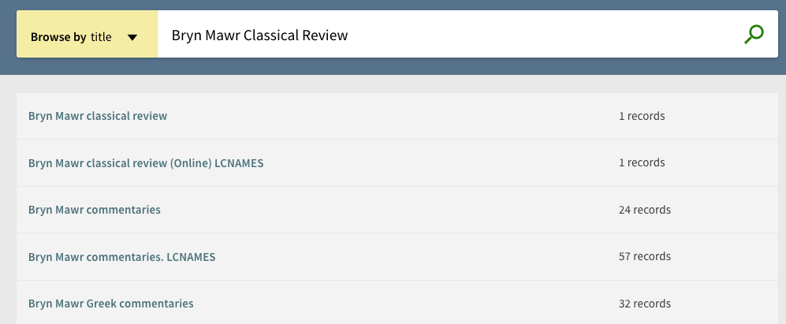
General Catalog Search: Precession through Title

Slide 12
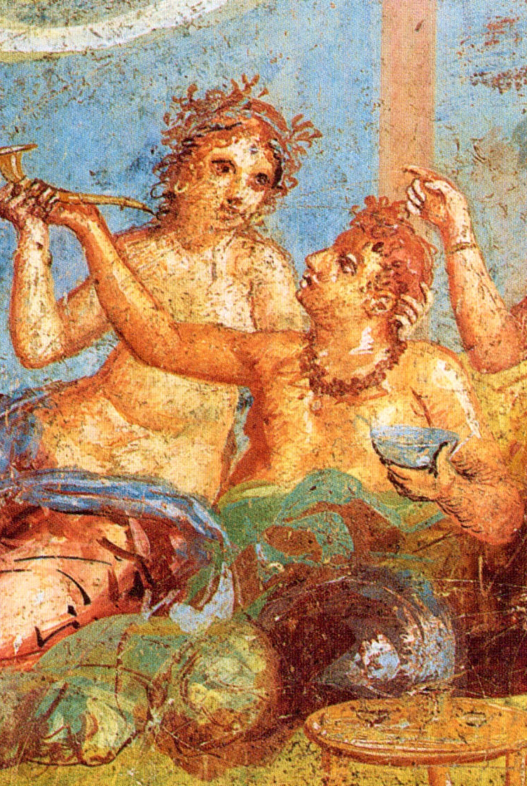
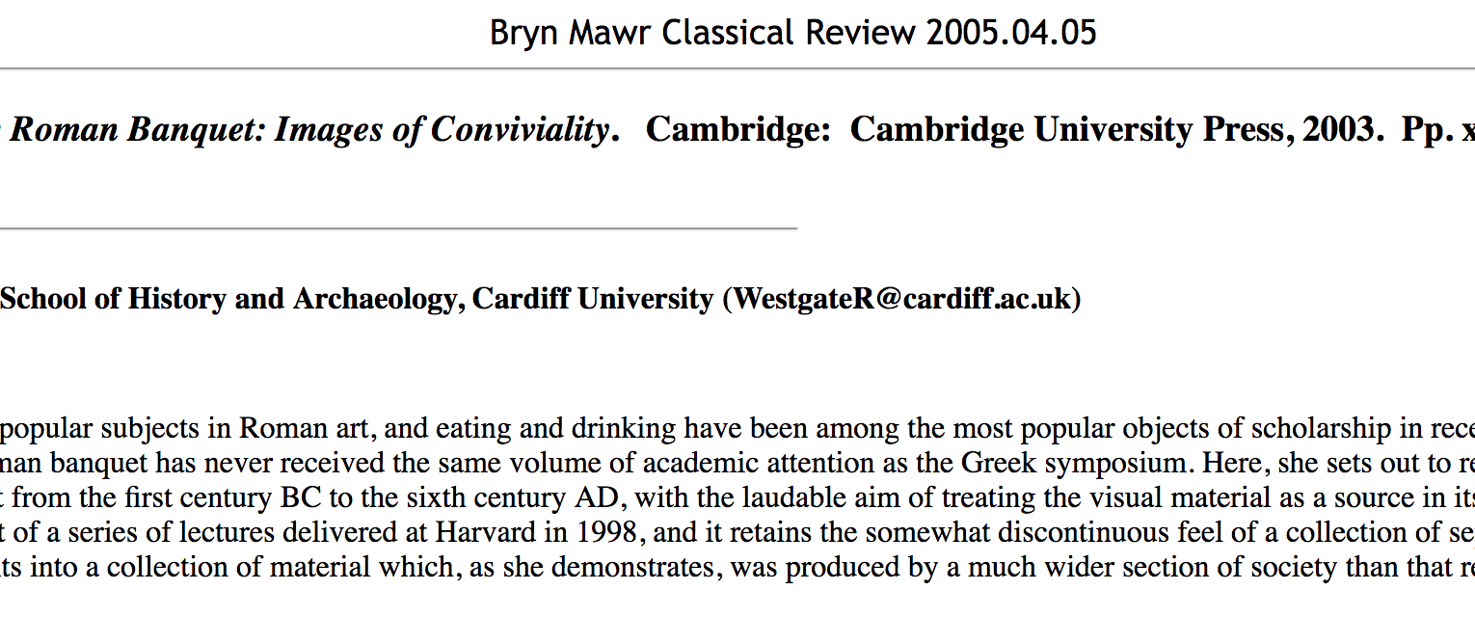
When in doubt about a resource: check!

Slide 13
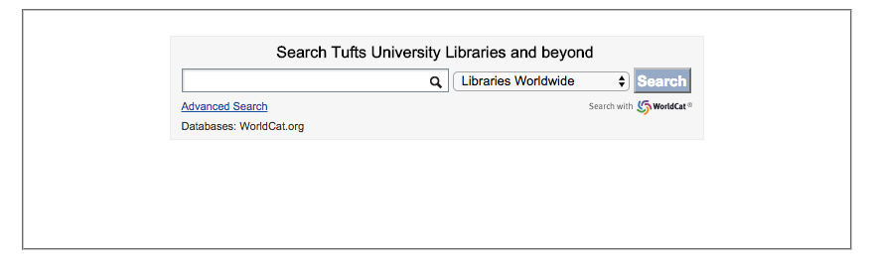
When you need to go Beyond…
BLC provides seamless access to millions of books through the Boston Library Consortium and research libraries worldwide.
BLC delivery time: usually 2-3 days
Interlibrary loan delivery time: usually 7-10 days, sometimes less

Slide 14
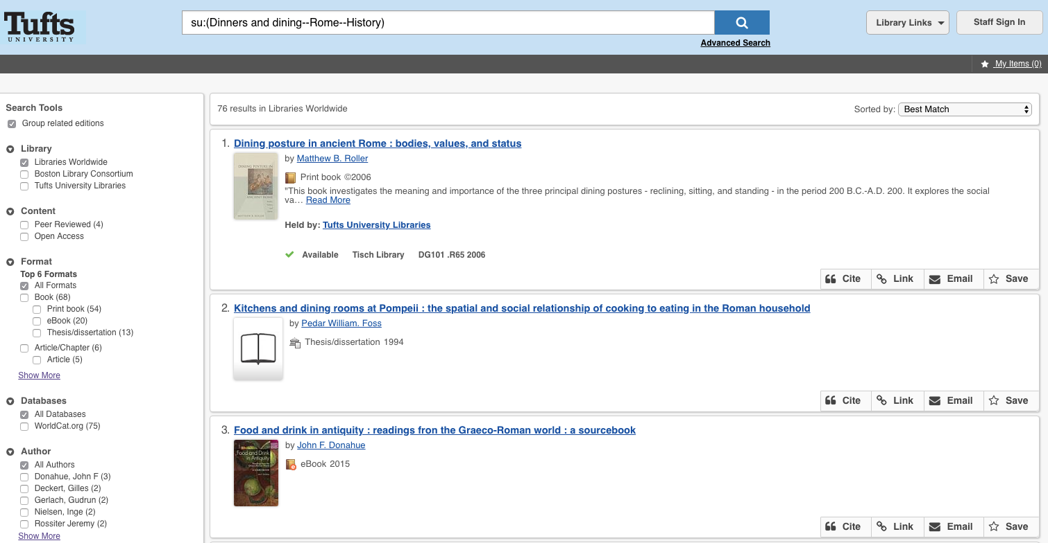

Slide 15
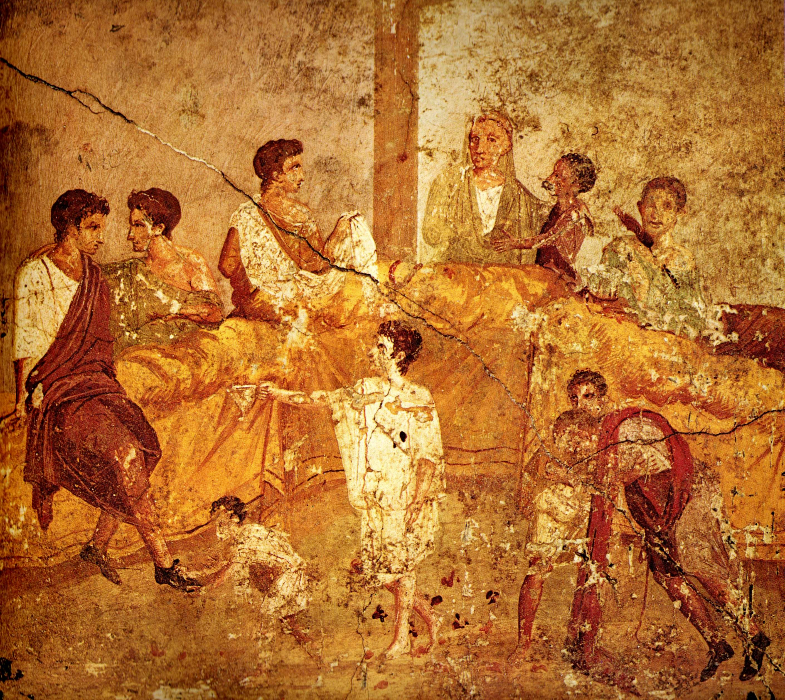
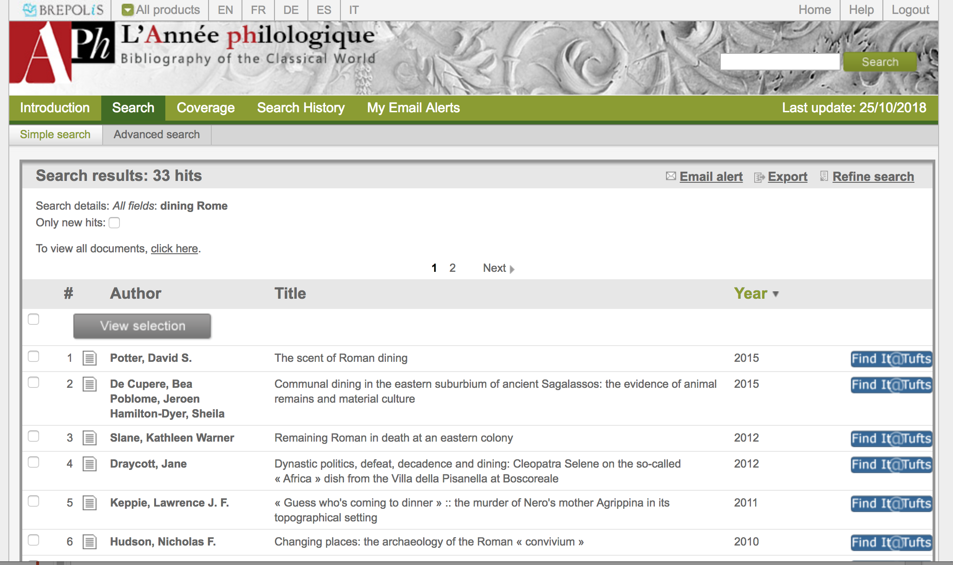
L’Année philologique
Notes:
L'année philologique
* books, articles, dissertations, everything relevant to Classics published anywhere.
* it's in many languages.
* there is no full text
NOTE: The subjects used in L’Annee are not the same as those used in libraries….

Slide 16
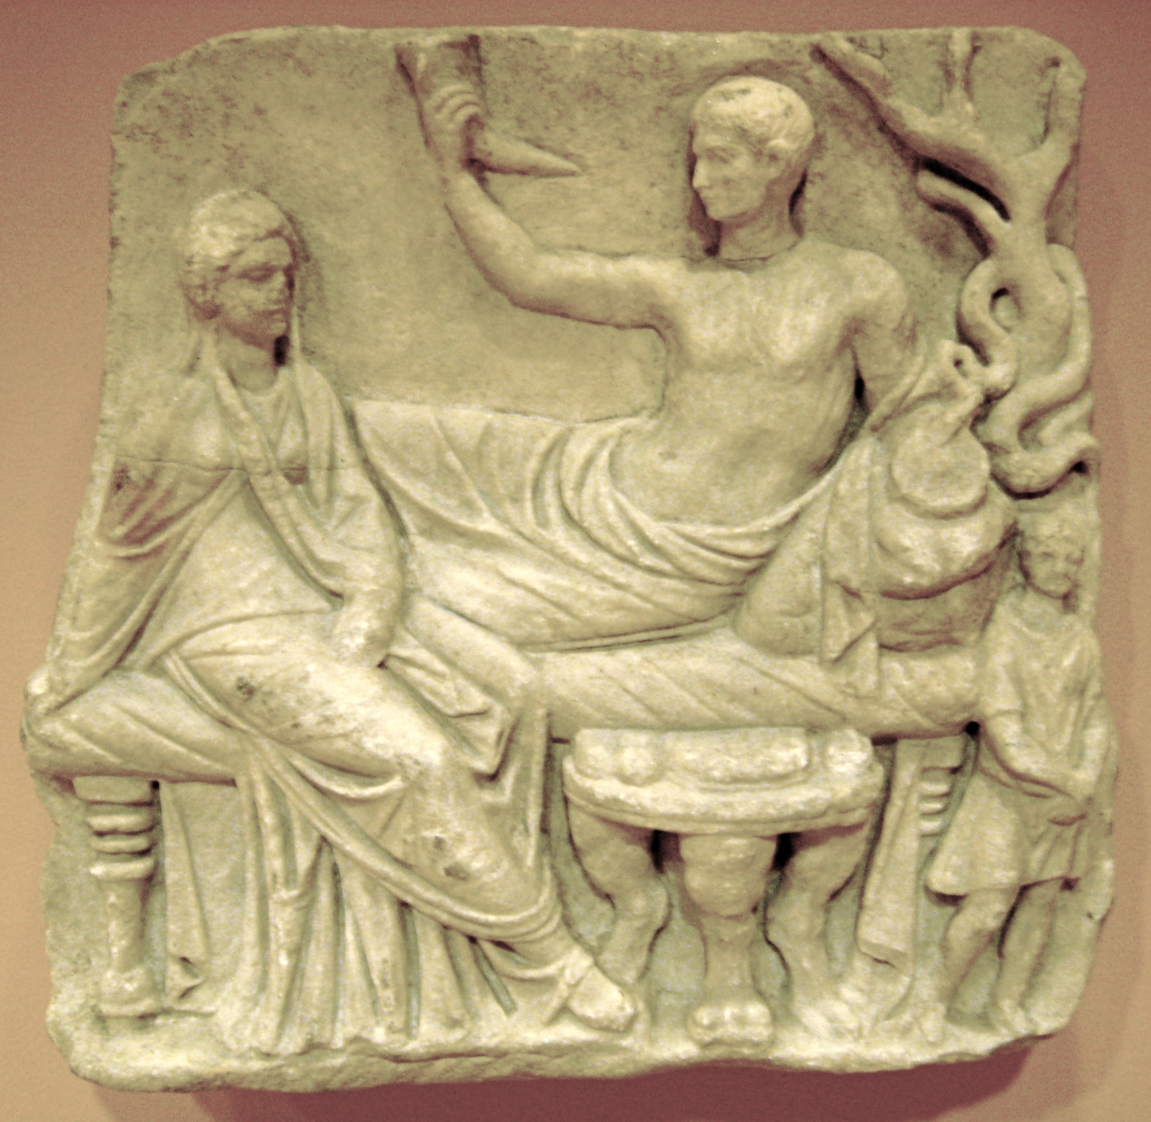
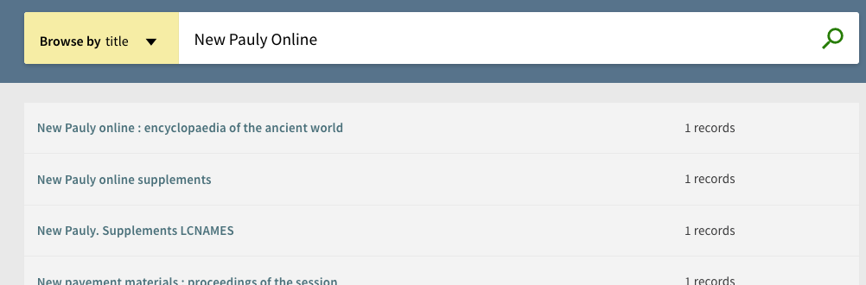
New Pauly Online
Notes:
A comprehensive encyclopedia of antiquity, with solid coverage of topics famous and obscure. Need a biography of Pseudo-Skimnos? This is the place. We also have a comprehensive collection of prior editions in the Pauly series.

Slide 17
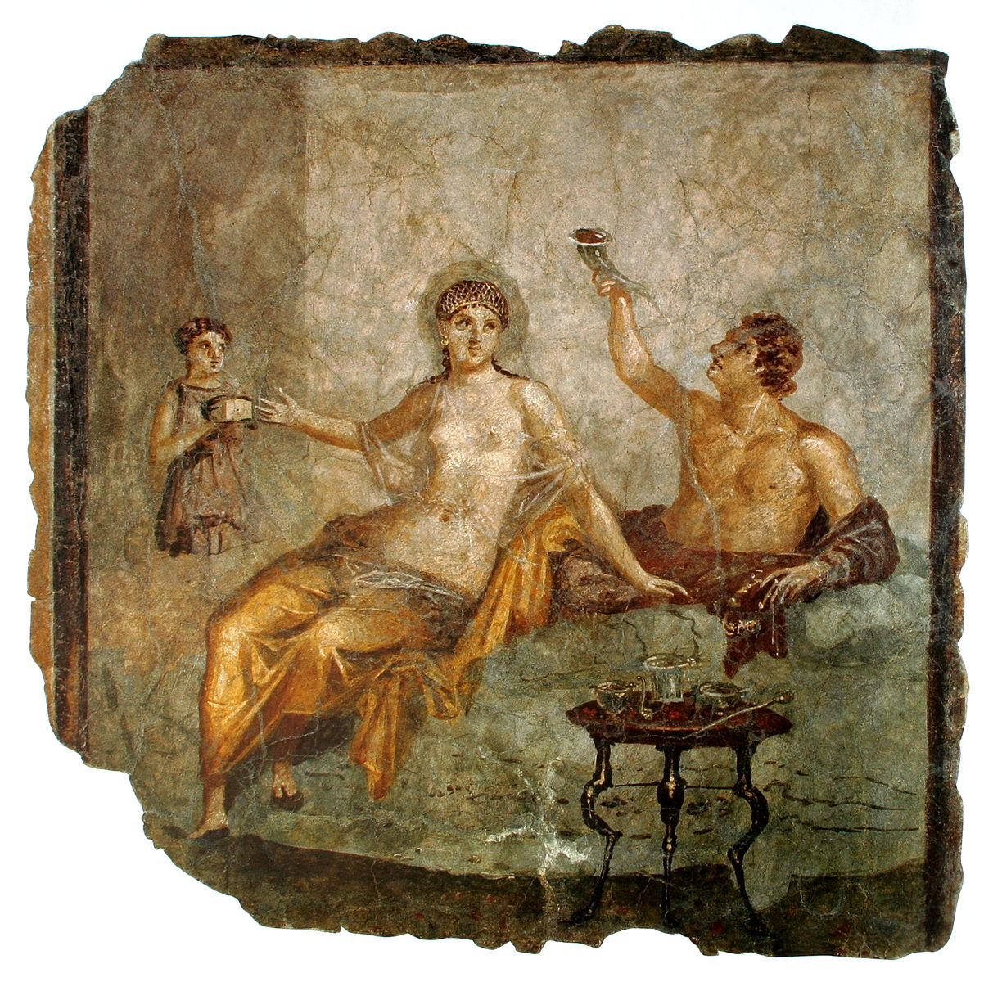
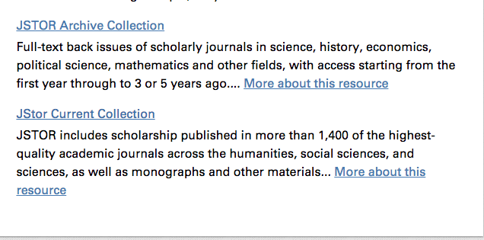
Finding Articles

Slide 18
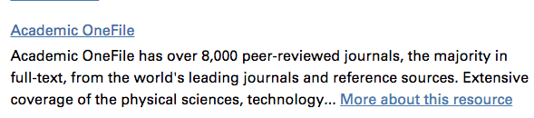
Finding Articles

Slide 19
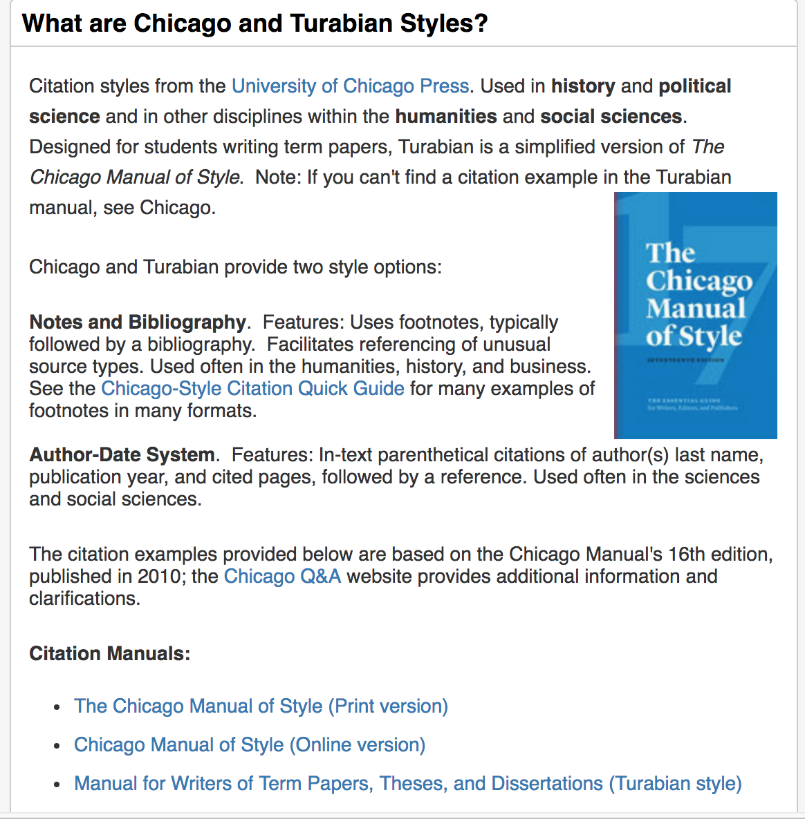
Citing your sources

